Slide 1
Quantitative Risk Assessment
&
Feasibility (Economics Appraisal)
1. HDR Scholarship Opportunities! 2. Internship – Graduate Programs still Open!

Slide 2
Quantitative Risk Analysis
A qualitative approach to make decisions and is more suitable for complex decision-making scenarios
More rigorous, computational, numerical, mathematical, etc.
We will learn the following techniques:
Sensitivity Analysis
Decision Tree Analysis
Event Tree Analysis
Fault Tree Analysis

Slide 3
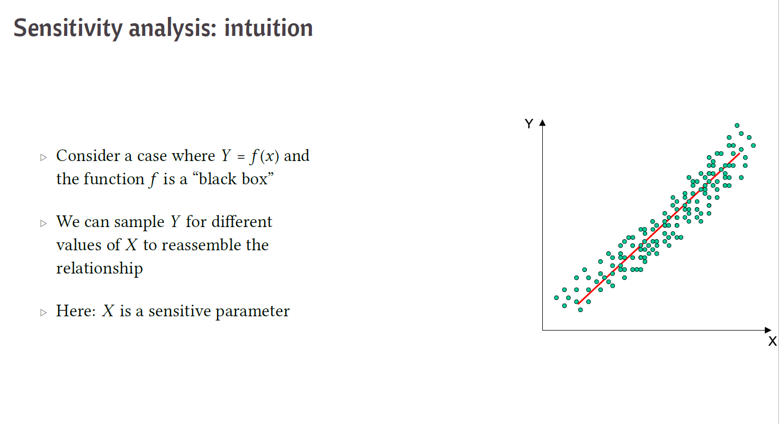
Sensitivity Analysis

Slide 4
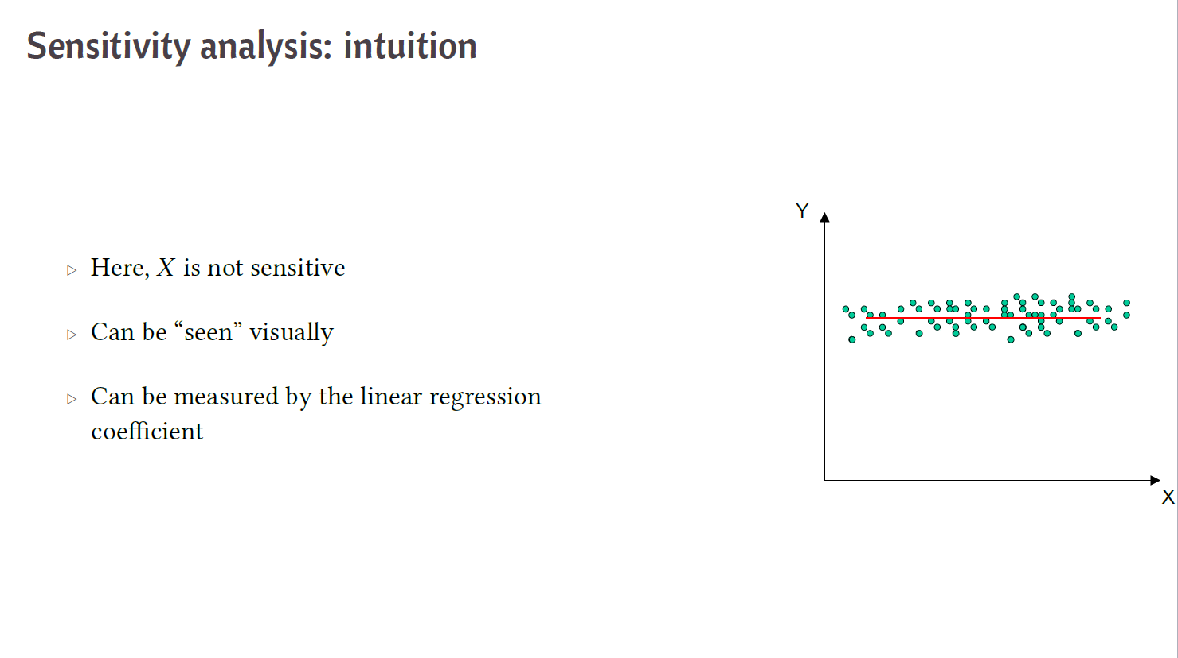
Sensitivity Analysis

Slide 5
Sensitivity Analysis
Sensitivity analysis examines each project risk on its own merit. It is an analysis process to determine which risks could affect the project the most.
All other risks in the project are set at a baseline value. The individual risk is then examined to see how it may affect the success of the project.
The goal is to determine which individual risks have the greatest impact on the project’s success and then escalate the risk management processes on these risk events.

Slide 6
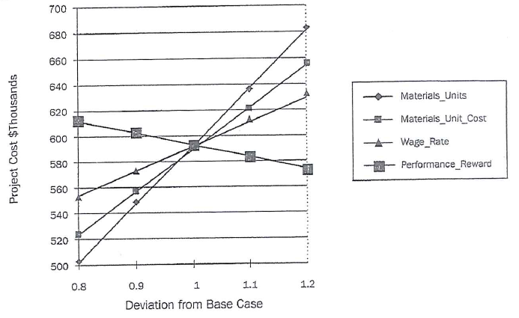
Sensitivity Analysis using Spider Diagram
Only one variable is changed at a time, holding the other variables at their base-line value

Slide 7
Sensitivity Analysis using Tornado Diagram
Example:
“We want to release new product in the market. Our target profit is $6 million by the end of this year”
We are interested to know – Which individual risk in the marketing category can influence our project objective to a greater extent?

Slide 8
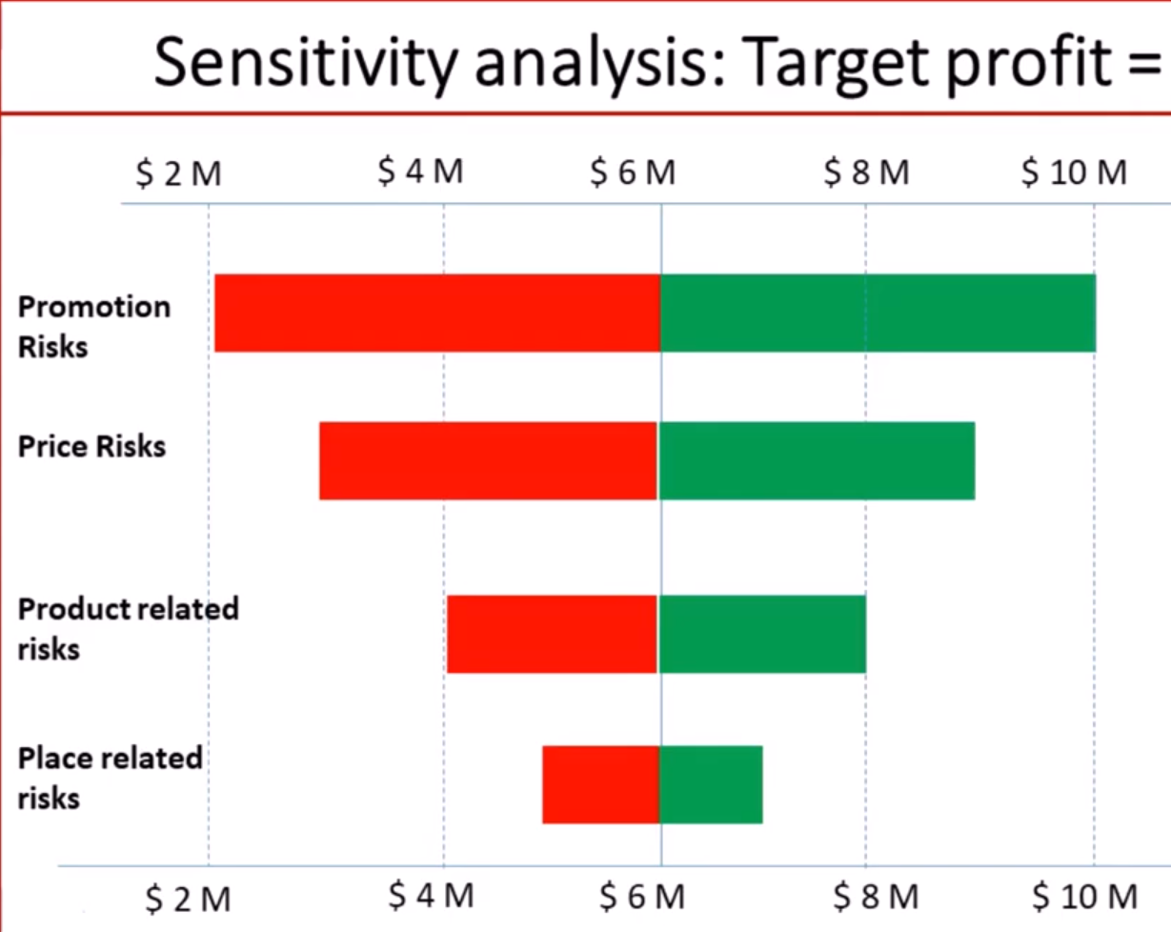

$6 M

Slide 9
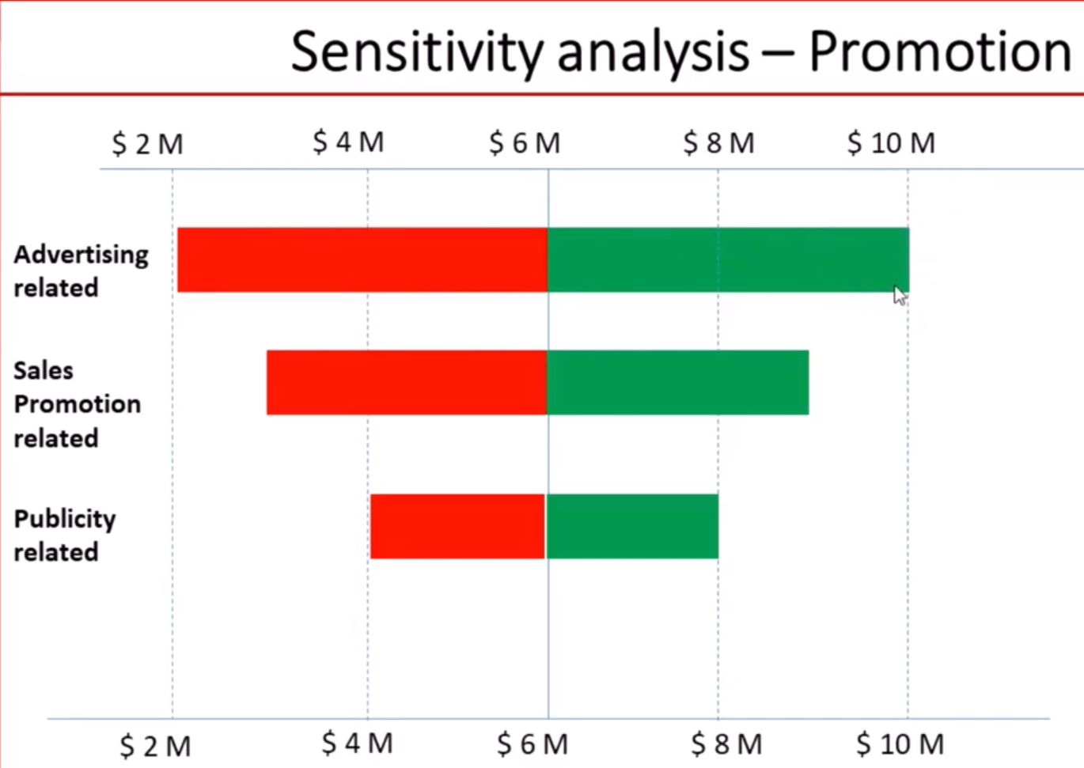

Slide 10

Sensitivity Analysis using Tornado Diagram
Sensitivity analysis on NPV
In statistics, we need to consider a concept named ‘Confidence Interval (CI)’, which means the chance the Population Mean falls between two endpoints. This is extremely important in Examining Product Quality via Sampling (a statistical concept of using the Sample Mean to reflect the Population Mean).
If CI=90%, it means there is a 90% chance the Population Mean ( ) will fall into the range.
µ
NPV
$ billion
00 2 4 6 8 10 12 14
Conversation 30%
25%
45%
Unit Price $25.5
$20.5
$29.5
Low
Inflation 5.5%
High
10.5%
2.5%
Fix rate 3.45%
4.3%
3%

Slide 11
Interval Estimates of the Mean
The interval estimate is the form favored by statisticians because it provides some acknowledgement of the error inherent in the sampling process.
Confidence Interval Estimates
In addition to reporting the point estimate for , we must provide information that indicates the accuracy of the estimate
i.e. a confidence interval for
A confidence interval estimates for a parameter consists of numbers obtained from a point estimate together with a percentage specifying how confident we are that the parameter lies in the interval.
The percentage is called the confidence interval.

Slide 12
Confidence Intervals
A random sample of size n is to be taken from a population with mean μ and standard deviation σ . Assume that the population is normally distributed or the sample size is large ( n ≥ 30 ).
Determine the probability that the interval
will contain the population mean μ , and interpret the result in terms of percentages.

Slide 13
Confidence Intervals
Using Table D, the probability is approximately 0.9544 that an observed value of is within 2 standard deviations to either side of the mean.
since and we can rewrite this equation
This can be rewritten as

Slide 14
Confidence Intervals
The probability is 0.9544 that the interval from
will contain μ .
If we take a large number of random samples of size n, then approximately 95.44% of the samples obtained will have the property that the interval with endpoints
contains the population mean μ .
Notes:
Sigma - σ

Slide 15
Expected Monetary Value (EMV)
The method considers the probability of each possible outcome and determines the average value of all outcomes
To determine the EMV, follow the below steps:
Identify the scenarios that could occur
Determine the probability of each scenario
Determine the monetary value associated with each outcome
Multiply the probability times the monetary value of each outcome
Sum the outcomes to get the expected monetary value of the risk or decision

Slide 16
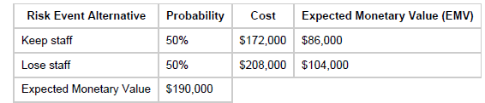
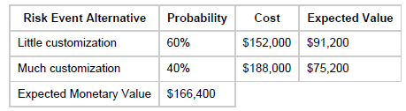
Expected Monetary Value (EMV)-Examples
Software company is analysing whether they are going to develop software in-house or purchase?
To develop software:
To purchase software:
Based on the analysis, Company will decide to purchase software

Slide 17



Here is another example.
Ice Cream Shop: if successful EMV would be $100
Which one should you choose?
Assuming that:
no initial costs; and
50% chance success for both options.
Juice bar: if successful EMV would be $ 90

Slide 18
In practice, we could combine Decision Tree Analysis to help us make informed decisions - let us look at this case
A company is deciding whether to bid for a certain project or not. They estimate that merely preparing the bid will cost $10,000. If their company bid then they estimate that there is a 50% chance that their bid will be put on the "short-list", otherwise their bid will be rejected.
Once "short-listed" the company will have to supply further detailed information (entailing costs estimated at $5,000). After this stage their bid will either be accepted or rejected.
They are considering three possible bid prices, namely $155,000, $170,000 and $190,000, including the decision to abandon the bid. They estimate that the probability of these bids being accepted (once they have been short-listed) is 0.90, 0.75 and 0.35 respectively. The company estimate that the labour and material costs associated with the contract are $127,000.
What should the company do and what is the expected monetary value of your suggested course of action?

Slide 20
Event Tree Analysis
Purpose: speculating (forwards) possible outcomes and probabilities of an initiating event (assuming the event has not happened yet)
The process involves:
Identifying an initiating event of interest.
Identifying the consequent events followed by the impact of the initiating event
Constructing the event tree
Describing the resulting accident event sequences

Slide 21
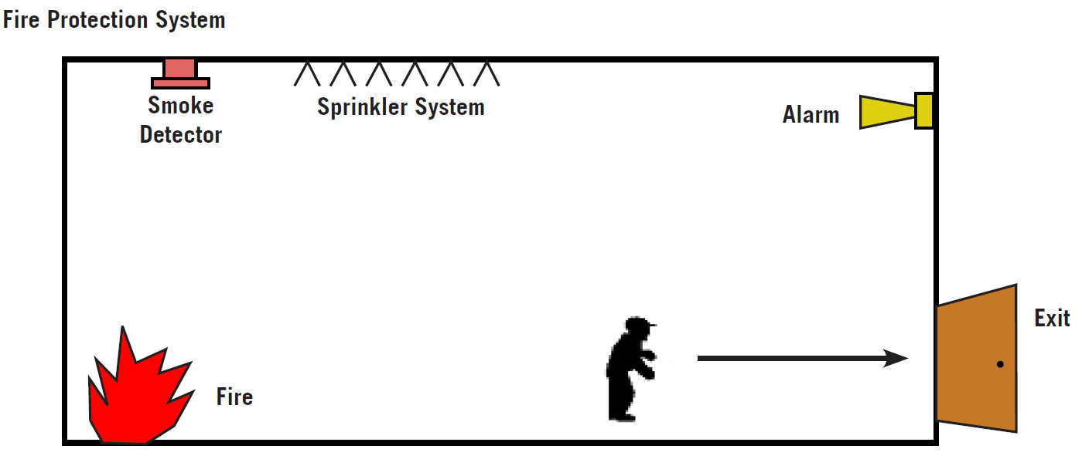

Event Tree Analysis-Examples

Slide 23
Fault Tree Analysis (opposite to ETA)
Purpose: deducing (backwards) possible reasons and probabilities that lead to an outcome (already happened)
FTA process involves:
An undesired event is defined
The event is resolved into its immediate causes
This resolution of events continues until basic causes are identified
A logical diagram called a fault tree is constructed showing the logical event relationships

Slide 24
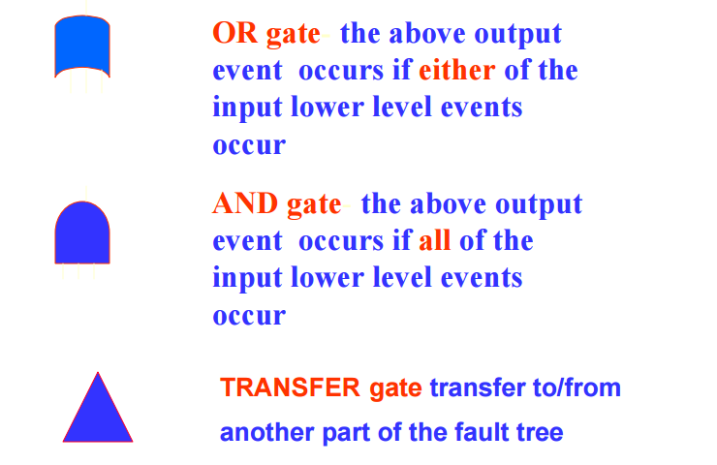
Car hitting an object

Slide 26
Economics-based project appraisal
How to appraise the feasibility of a project? We should consider to:
Assess the financial aspects (economics perspectives.
&
Assess the environmental and social aspects (non-economics perspectives)
Before deciding ‘Go’ or ‘No go’
Does a dollar today have the same value tomorrow?

Slide 27
FINANCIAL STUFF!!!
Costs | Benefits
loan/mortgage (A) | Profit made from sale, rental, or other services (B)
operation cost (O)* | Salvage or residual value (L_{n})
maintenance cost (M)*
A Typical Cash Flow
L_{n}
Start
0
Year
1
Year
2
Year
n-1
End
n

Slide 28
Cash Flows-Compounding & Discounting
$$F=P{(1+i)}^{n}$$
i= interest rate
Compounding
Present Amount (P)
Future Amount (F)
Discounting

Slide 29
Cash Flows-Major Formulas
$$F=P {(1+i)}^{n}$$
Compound Factor = ${(1+i)}^{n}$
$$P=F/{(1+i)}^{n}$$
Present Value Factor/ Discount Factor =$1/{(1+i)}^{n}$
Notes:
This is how we can actually increment the present value towards the future, or, discount the future value to the present value!!!!

Slide 30
Cash Flows-Major Formulas
L_{n}
$$F=A[\left(1+i\right)n−1]/i$$
Compound Factor for an Annuity
$$A=F \frac{i}{\left(1+i\right)n−1}$$
Sinking Fund Deposit Factor
A
A
A
A
A
A
A
Start
0
Year
1
Year
2
Year
3
Year
n-3
Year
n-2
Year
n-1
End
n
F

Slide 31
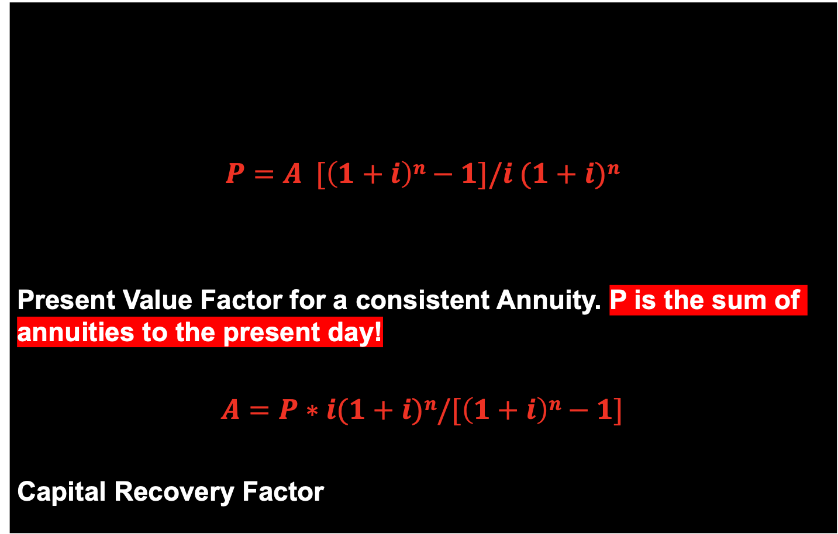
Cash Flows - Major Formulas
L_{n}
$$P=A [\left(1+i\right)n−1]/i (1+i)n$$
Present Value Factor for a consistent Annuity. P is the sum of annuities to the present day!
$$A=P∗i(1+i)n/[\left(1+i\right)n−1]$$
Capital Recovery Factor
A
A
A
A
A
A
A
Start
0
Year
1
Year
2
Year
3
Year
n-3
Year
n-2
Year
n-1
End
n
P

Slide 32
Besides, other financial metrics can also help the investor to further consider the project feasibility:
Benefit-Cost Ratio (BCR)
Net Present Value (NPV), similar to EVM and PV.
Payback Period (PB)
Internal Rate of Return (IRR)

Slide 33
$BCR=\frac{Present Value of Annual Benefits}{Present Value of Annual Costs}$
$BCR≥1$ is an indication that the project is financially viable and can be continued for further consideration of implementation
BCR can be misleading if projects differ significantly in size, for example, if proposal A has a PV of benefits of 200 and PV of costs of 100, it has a NPV of 100 and a BCR of 2. If the alternative proposal, B, has a PV of benefits of 600 and costs of 400, it has a smaller BCR (1.5) but a larger NPV (200). It would be more efficient to choose proposal B.

Slide 34
Example: two alternative designs have been put forward for the construction of a new desalination plant in Victoria. It has been decided to adopt the benefit cost ratio as the method and upon its values to decide the successful project. Given that the economic life of the desalination plant is set at 25 years and the interest rate set at 10%. Also, the information in the table below can be used to decide which option should be adopted. The cost of the water to the public will be the same irrespective of which design is chosen (Assume 1.50$/ ML).
 | Design I | Design II
Initial Cost | $25,000,000 | $10,000,000
Annual Costs (Operation and Maintenance) | $100,000 | $100,000
Annual Production (ML) | 2,500,000 | 1,000,000

Slide 35
Solution (which function are we gonna use?)
Design I
$$B=2.5∗1.50=3.75; C=25 [0.1(1+0.1)25/\left\{\left(1+0.1\right)25\right.−1\}]=2.754; C′=0.1$$
$$∴BCR=\frac{3.75}{2.754+0.1}=1.304$$
Design II
$$B=1.0∗1.50=1.50; C=10 [0.1(1+0.1)25/\left\{\left(1+0.1\right)25\right.−1\}]=1.101; C′=0.1$$
$$∴BCR=\frac{1.50}{1.251}=1.199$$
BCR of Design I > Design II, ∴ Design I is selected

Slide 36
Net Present Value (NPV)
The NPV is the sum of the present values of the net benefits minus the costs associated with the project
A positive NPV indicates that the benefits will exceed costs over the lifetime of the project
When comparing projects, the highest NPV will be selected
Discount rate is crucial to the project
Not good for comparing projects of different lifetimes

Slide 37
NPV = $−$Ι₀ + (Β−C)PVF_{i,n} + L_{n}/(1+i)^{n}
^{Where:}
I0 – Initial capital investment
B – annual net benefits
C – annual net costs
PVF_{i,n} – present value factor = [(1+i)^{n} -1]/i(1+i)^{n}
L_{n} – liquidation yield (residual value)
i – discount rate
n – number of years

Slide 38
Example
Two alternative designs have been put forward for the construction of a new retail park near Geelong.
In option 1 the survey work will cost of $1,000,000, the purchase of the required land will cost $50 million and the construction will cost a further $150 million. Operating and maintenance costs will be $20 million a year. The retail park is expected to have 5 million customers a year, each person expected to spend in $10. At the end of the operational period the land will have a re-sale value of $4 million
In the second alternative the construction cost will be $250 million and the land purchase $60 million. The survey cost will be the same as for alternative 1. Operating costs will be $25 million per year with salary costs at 20% of operation costs. The expected income from customers is expected to be $100 million but the site will have no resale value.
Both alternatives will have a design life of 50 years and discount rate of 7.5% has been selected as appropriate for the project.
Based on NPV, determine which option should be selected?

Slide 40
PayBack (PB) Period
$\text{PB}\text{=}\frac{\text{Initial} \text{Cost}}{\text{Annual} \text{Cash} \text{Inflow} \left(\text{Net} \text{Benefit}\right)}$=$\frac{\text{I}\text{0}}{\text{(}\text{B}\text{−}\text{C}\text{)}}$
The time required to pay back the investment in the project
Payback period does not take into account the change in value of money with time
Favours projects which generate high benefits in early years compared to projects which give substantial benefits in later years

Slide 41
Example
Planning team of a construction company is considering two design options for a community market building. One involves the use of timber, the other uses structural steel. Using following data, choose the better option on the basis of Pay Back Period?
(Assume discount rate is 10%)
 | Timber | Steel
Initial Cost | $80000 | $120000
Annual Operation and Maintenance Cost | $12000 | $8000
Annual Benefit | $25000 | $20000

Slide 42
Solution

Slide 43
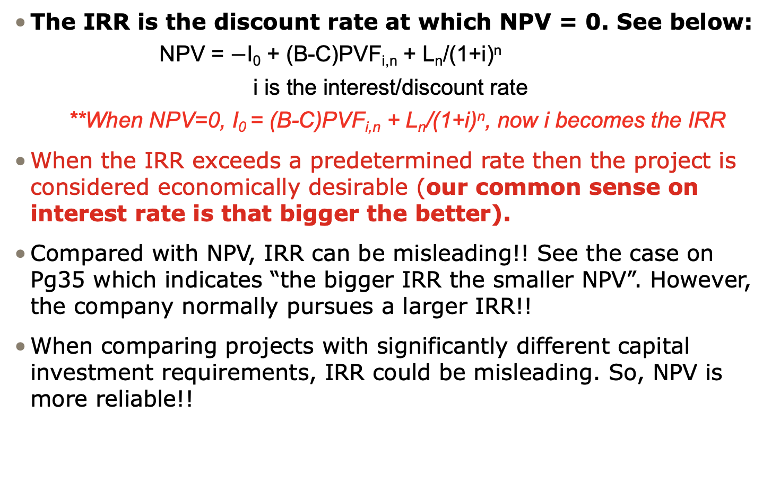
Internal Rate of Return (IRR)
The IRR is the discount rate at which NPV = 0. See below:
NPV = $−$I₀ + (B-C)PVF_{i,n} + L_{n}/(1+i)^{n}
i is the interest/discount rate
**When NPV=0, I₀ = (B-C)PVF_{i,n} + L_{n}/(1+i)^{n}, now i becomes the IRR
When the IRR exceeds a predetermined rate then the project is considered economically desirable (our common sense on interest rate is that bigger the better).
Compared with NPV, IRR can be misleading!! See the case on Pg35 which indicates “the bigger IRR the smaller NPV”. However, the company normally pursues a larger IRR!!
When comparing projects with significantly different capital investment requirements, IRR could be misleading. So, NPV is more reliable!!

Slide 44
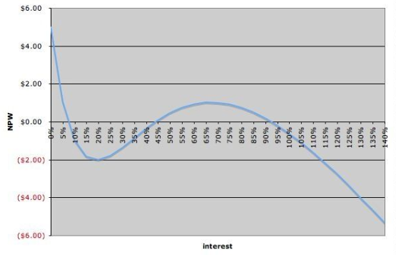
Other than this, if a project has multiple cash inflows and outflows in the future, there will be multiple Discount Rates (therefore at least two IRRs).
For example, an investment option I₀=100，1st year cash inflow =200，3rd year cash outflow = 100, I = 10%
So given NPV = NPV₁ + NPV₂ + NPV₃ = -100 + 200/(1+IRR) +(-100)/(1+IRR)^2 = 0 this function becomes a Quadratic equation with one unknown factor (see below), IRR will have 3 values. So NPV is more reliable!!

Slide 45
Example
A manufacturing company has decided to evaluate the construction of the proposed new production line. If the IRR is less than 10%, company may not continue with the proposed project. Based on the information below, determine if the project should be allowed to proceed?
Land Purchase | $2,500,000
Construction | $7,500,000
Operational Costs per annum | $250,000
Net benefits per annum | $1,000,000
Service Life | 20 years
Residual Value | $2,000,000

Slide 46
Solution

